Slide 1

Austin Transportation Department Signs Work Orders
Created By: Susanne Gov Created Date: 2020-05-21 Location Name: LAKE AUSTIN BLVD / ATLANTA ST Intersection ID: 5153187 Cardinal Direction: N
Sign Type | Install/Remove

Slide 2
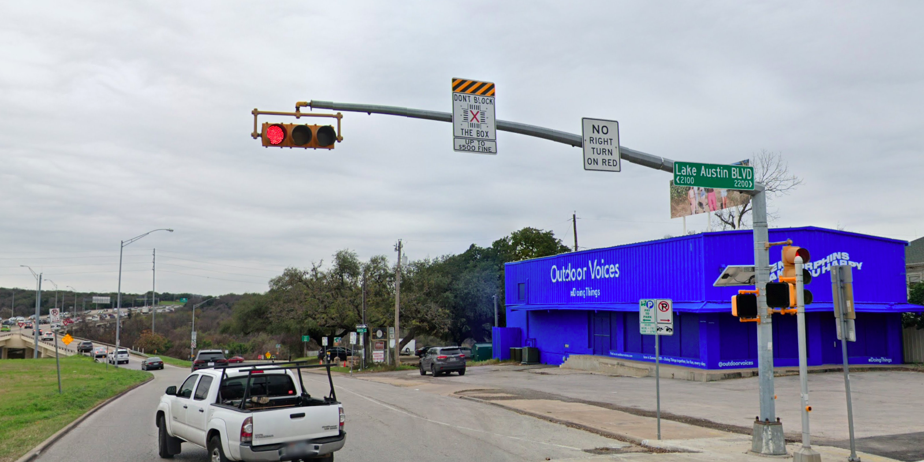
Austin Transportation Department Signs Work Orders
Created By: Susanne Gov Created Date: 2020-05-21 Location Name: LAKE AUSTIN BLVD / ATLANTA ST Intersection ID: 5153187 Cardinal Direction: S
Sign Type | Install/Remove
Street Name Sign | Install
No Right Turn On Red | Install
Don’t Block the Box | Install

Slide 3
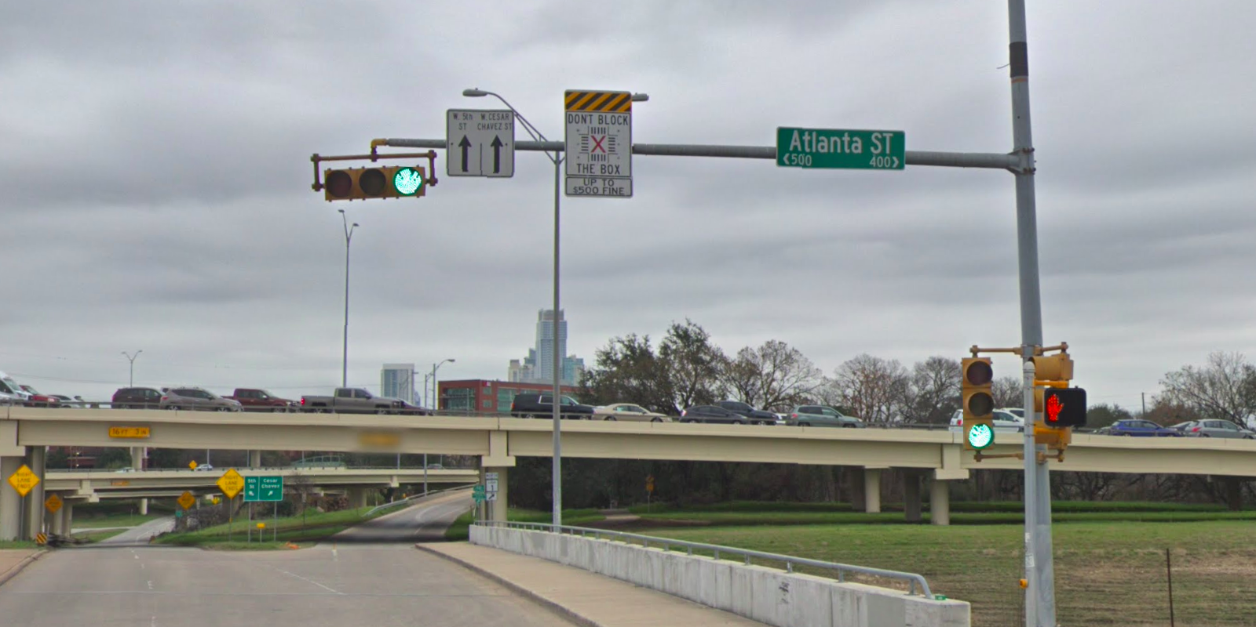
Austin Transportation Department Signs Work Orders
Created By: Susanne Gov Created Date: 2020-05-21 Location Name: LAKE AUSTIN BLVD / ATLANTA ST Intersection ID: 5153187 Cardinal Direction: E
Sign Type | Install/Remove
Left Turn Arrow Only | Install
Street Name Sign | Install
Straight Arrow Street | Install
Straight Arrow Street | Install
Don’t Block the Box | Install

Slide 4
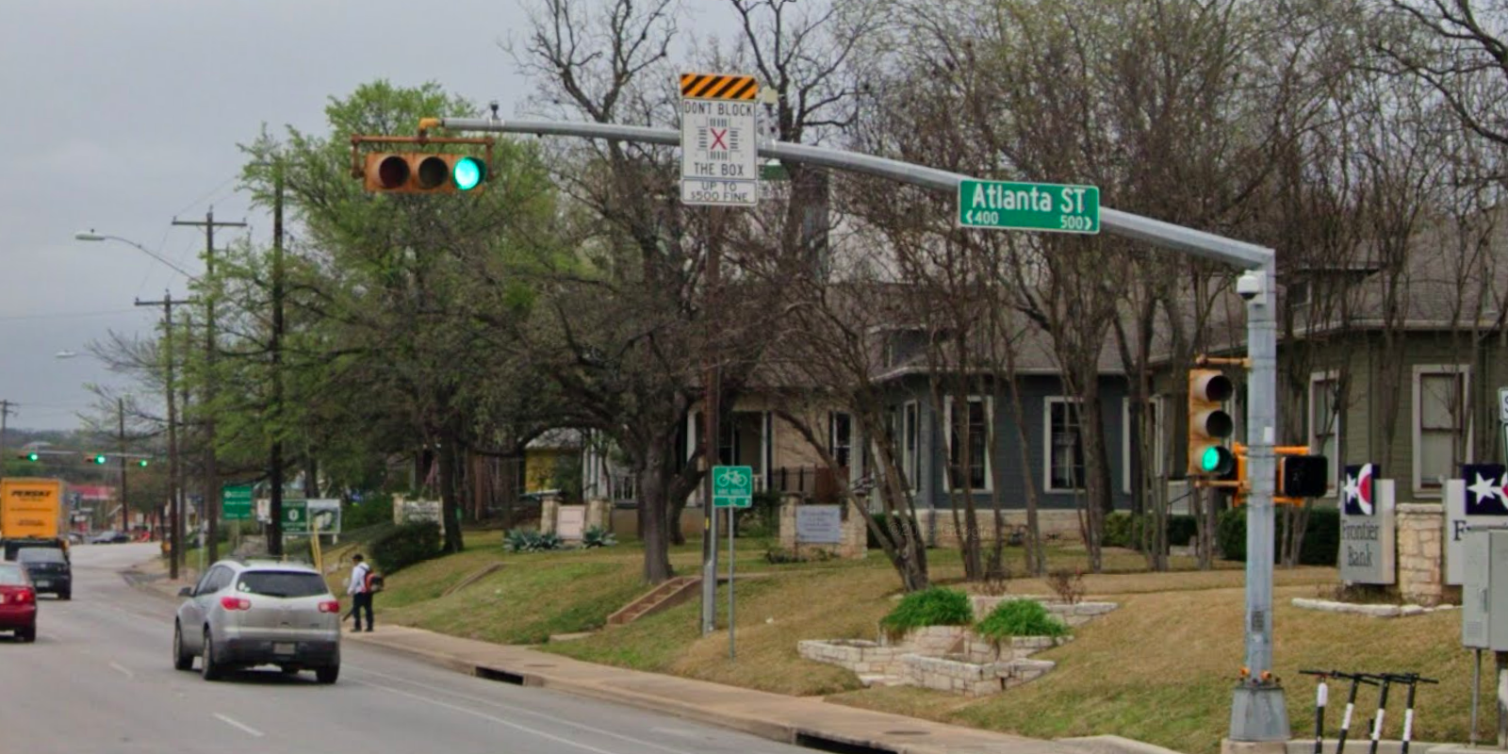
Austin Transportation Department Signs Work Orders
Created By: Susanne Gov Created Date: 2020-05-21 Location Name: LAKE AUSTIN BLVD / ATLANTA ST Intersection ID: 5153187 Cardinal Direction: W
Sign Type | Install/Remove
Street Name Sign | Install
Don’t Block the Box | Install

